Slide 1
Future of Transport, Movement & Logistics
Max Stucki 13.5.2021

Slide 2
Introduction
Max Stucki
Foresight Analysis Manager
Futures Platform
max.stucki@futuresplatform.com

Slide 3
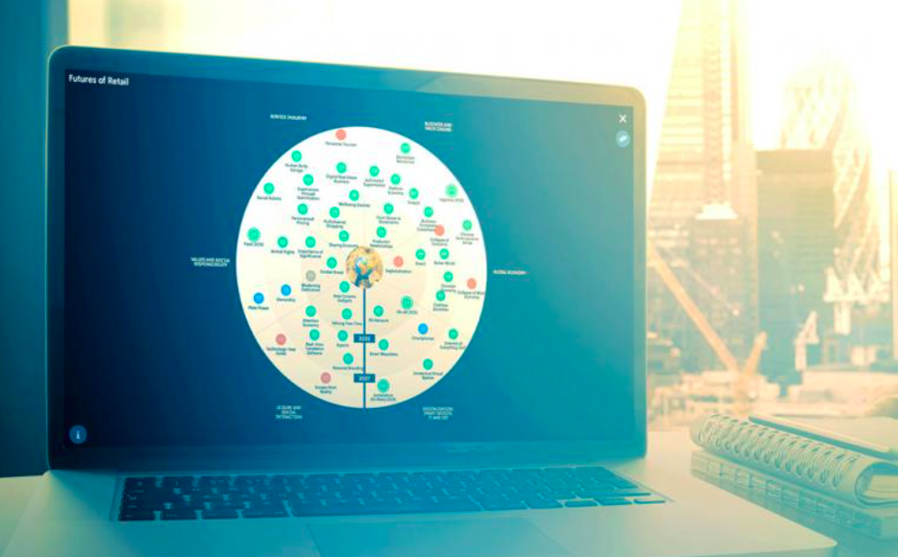
Futures Platform
Futures Platform is a software and advisory company from Finland, specializing in Future Foresight development and optimization.
We offer a digital AI platform to organizations globally to conduct foresight work.
Futures Platform is familiar working with private corporations and public organisations, having successfully completed foresight and scenario projects, as well as having implemented the AI based platform as a solution for many public and private clients.
References

Slide 4
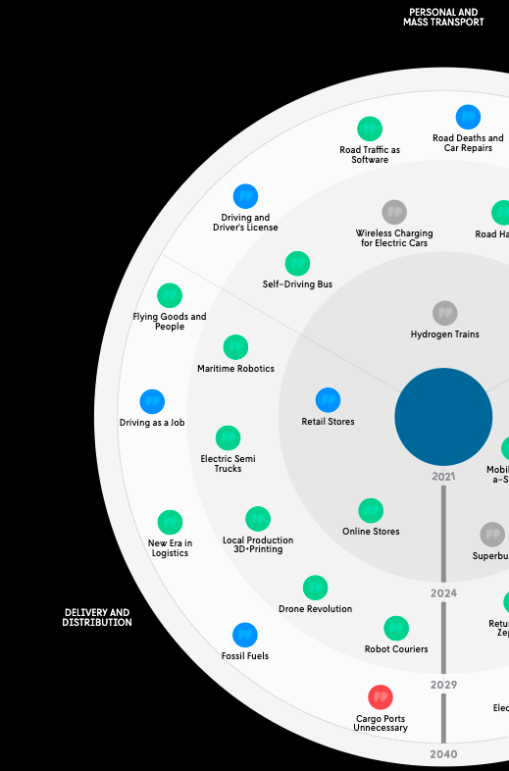
Before we start..
Foresight:
Insight + assessment about the future development
Internal analysis process at Futures Platform
Ready analysis product called futures intelligence
Foresight Radar
Sectors
Time ranges
Phenomena (dots in the radar: trends, drivers..)
Green strengthening
Blue weakening
Gray weak signal
Red wild card

Slide 5
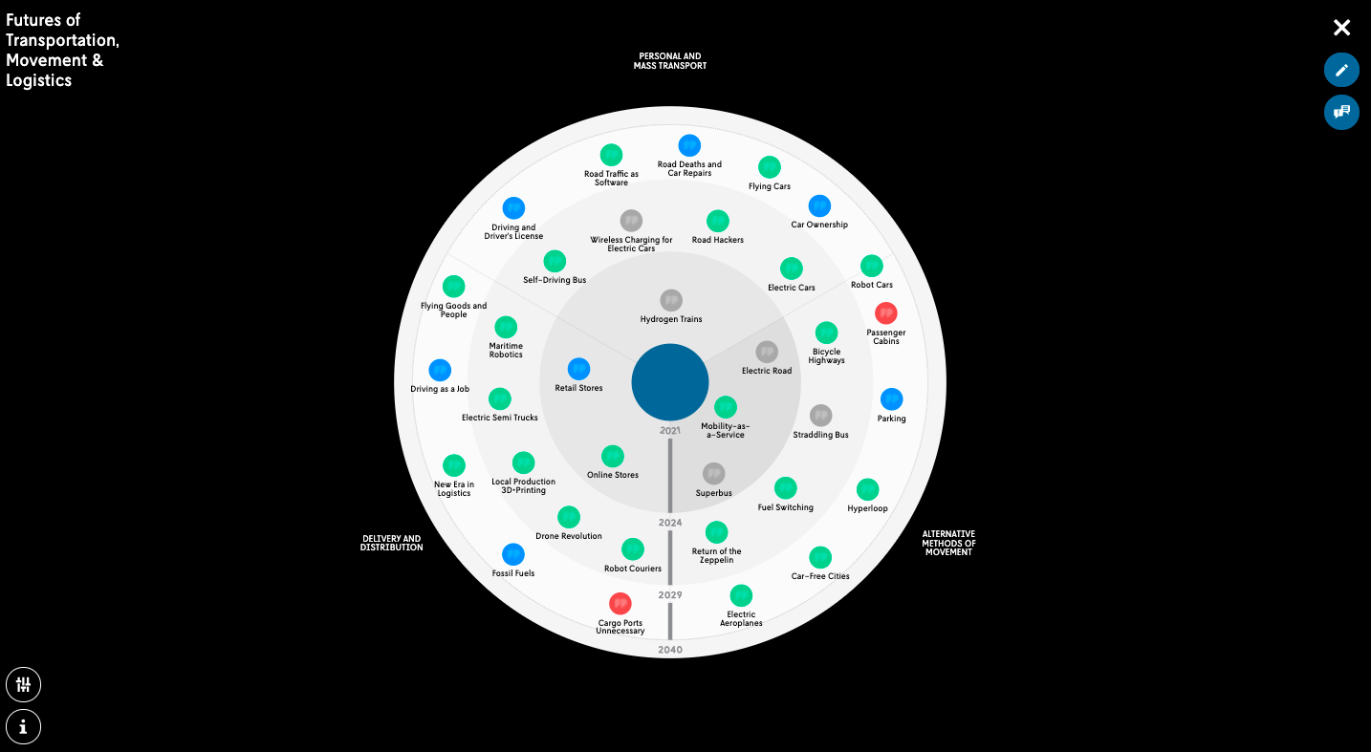

Slide 6
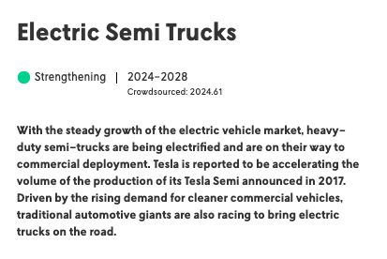
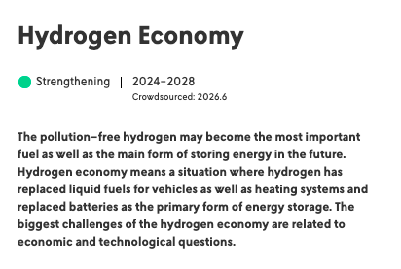
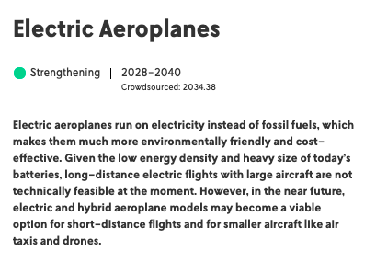
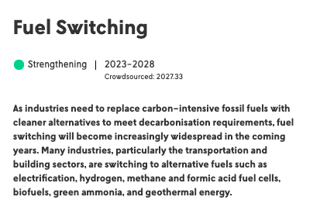
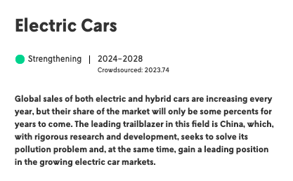
Future of movement: sustainability

Slide 7
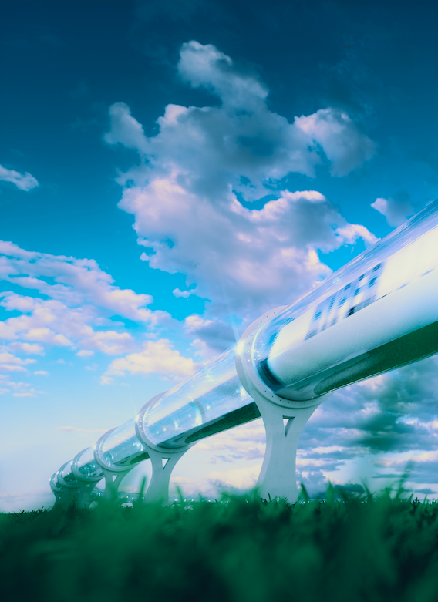
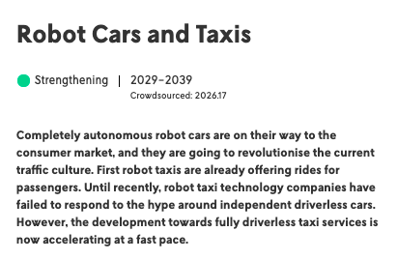
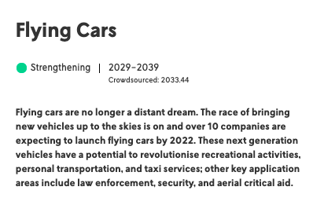
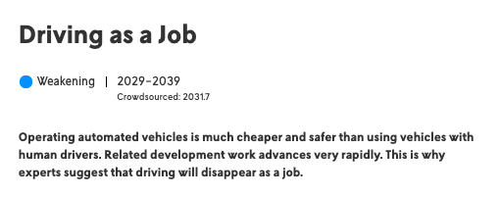
Future of movement: robotics and air

Slide 8
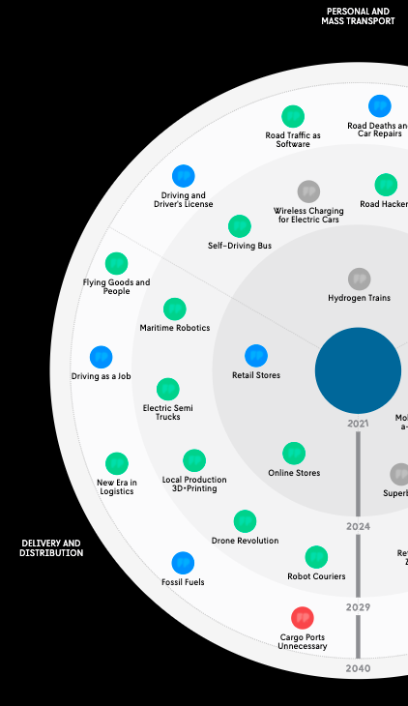
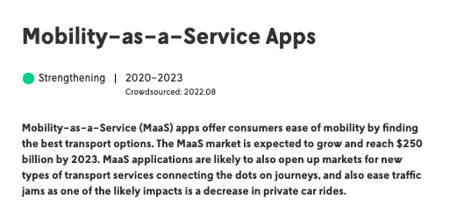
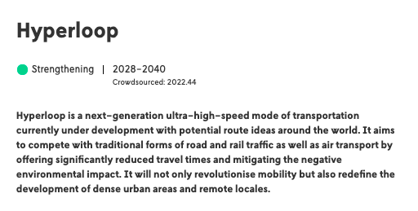
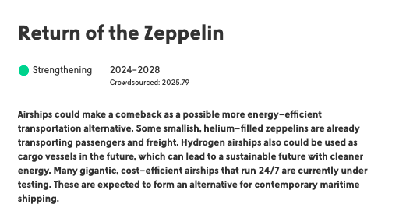
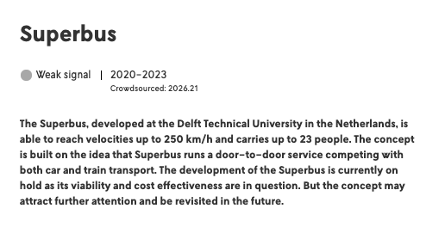
Future of movement: alternatives

Slide 9
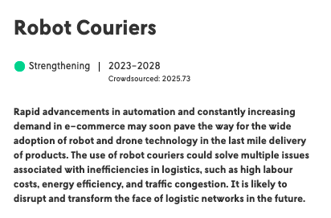
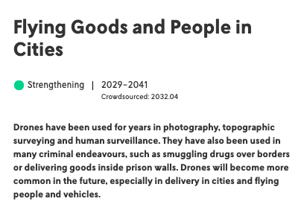
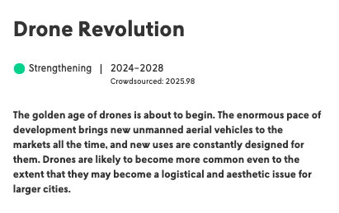
Future of logistics: drones, automation

Slide 10
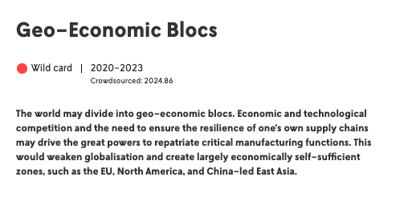
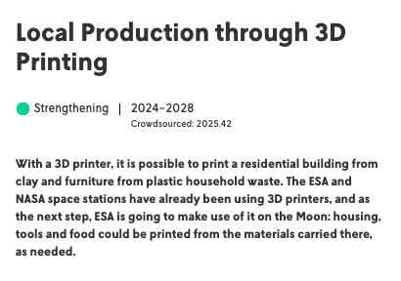
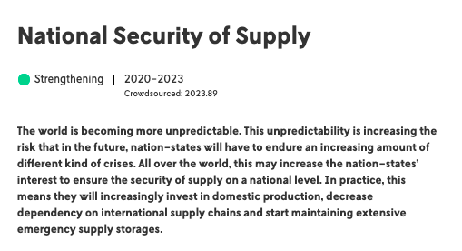
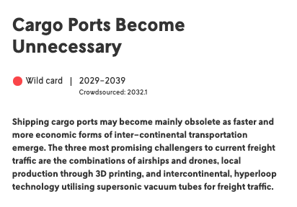
Future of logistics: larger changes?

Slide 11
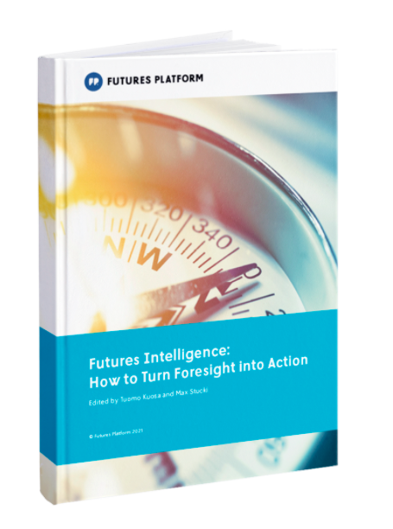
Thank you!
max.stucki@futuresplatform.com
https://www.futuresplatform.com/
LinkedIn
Free eBook Futures Intelligence

